Slide 1
Rockbuster Stealth Data Analysis
Lisa Ward
4/22/2023
225
#2

Slide 2



Introduction
Rockbuster’s next challenge is to bring services online to compete with streaming competitors such as Netflix and Amazon Prime. For the 2020 company strategy we are going to focus on the following questions:
Which movies contributed the most/least to revenue gain?
What was the average rental duration for all videos?
Where are the customers with a high lifetime value based?
Do sales figures vary between geographic regions?

Slide 3


Revenue by Title
As you can see Telegraph Voyage, Zorro Ark, and Wife Turn were the highest earners. While Texas Watch, Oklahoma Jumanji, and Duffel Apocalypse were the lowest earners.

Slide 4

Revenue by Category
Top 5 Movie Categories:
Sports
Sci-Fi
Animation
Drama
Comedy

Slide 5
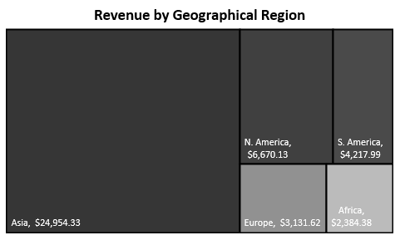
Revenue by Geographic Region
Asia is a leader in revenue followed by North America and South America.

Slide 6
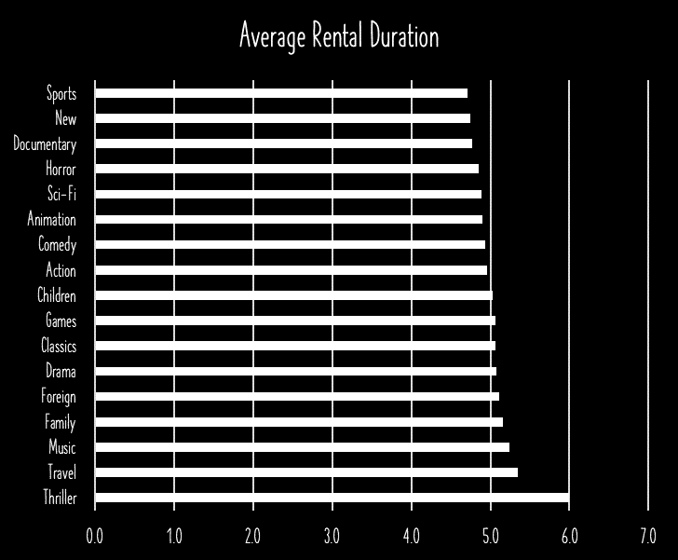
Inventory Data: Rental Information
Rental Duration
Minimum | 3 Days
Maximum | 7 Days
Average | 5 Days
Rental Rate
Minimum | $0.99
Maximum | $4.99
Average | $2.98
Movie Length
Minimum | 46 Minutes
Maximum | 185 Minutes
Average | 115 Minutes
Replacement Cost
Minimum | $9.99
Maximum | $29.99
Average | $19.98
Even though Thriller was the lowest earner, it has the longest rental length. The rest of the categories remain around the 5 day mark.

Slide 7





Top 5 Countries with the Highest Numbers of Customers
India (60)
China (53)
United States (36)
Japan (31)
Mexico (30)

Slide 8

Top 10 Countries with Highest Customer Lifetime Value
Of the Top 10, the Top 5 are India, China, United States, Japan, and Mexico. These countries also have the highest customer counts.

Slide 9
Summary
The top 3 movies that bring in the most revenue: The Telegraph Voyage, Zorro Ark, and Wife Turn.
The top 3 movies earning the least revenue: Texas Watch, Oklahoma Jumanji, Duffel Apocalypse.
The average rental duration is 5 days.
The top 5 countries with the highest number of customers: India, China, United States, Japan, and Mexico.
The customers with the highest lifetime value are based in India, China, United States, Japan, Mexico.
Top 5 film categories: Sports, Sci-Fi, Animation, Drama, Comedy.

Slide 10
Recommendations
Focus marketing efforts in:
Asia, North America, and South America. These are the 3 top Revenue earners.
High Revenue categories, such as Sports, Sci-Fi, Animation, Drama, and Comedy.
Eliminate low earning Movies such as those in the Thriller category and replace with high earning categories.
Develop mobile App that is easy to use.
Develop a customer reward program

Slide 11
Thank you!
Do you have any questions?
Lisa.Anne.Ward@gmail.com
312-848-3439

